Slide 1
Friction

Slide 2
What factors affect friction?

Slide 3
What factors affect (the size of) friction?
Survey says:
Surface texture
Surface material
Surface area
Speed of slide
Mass
Weight
Angle of surface
Normal Force

Slide 4
What is the mathematical relationship between…..
friction force (N) and normal force (N) for an object that is slid at a constant speed across a level surface?

Slide 5
Which FBD applies?

Slide 6
Kinetic friction vs Normal Force
What is the mathematical relationship between kinetic friction force (N) and normal force (N) for an object sliding across a level surface?
Consider this: What is the normal force acting on a hovering hovercraft? How much kinetic friction does the floor exert on the hovercraft as it glides across the floor?

Slide 7
Friction, Continued
Demo
Reading
Discussion

Slide 8
What is happening here?

Slide 9
What is happening here?
From 0-2s NOTHING
Just after 2.0s, a force is applied.
From 2 – 7 seconds the applied force gets larger (but the object did not slide). During this interval, the applied force …
At about 7.0s, the applied force has… and the size of the applied force drops from about 2N to just over 1N.
From 7-10s the applied force remains essentially constant while the object was sliding at a constant speed. During this interval, the applied force …

Slide 10
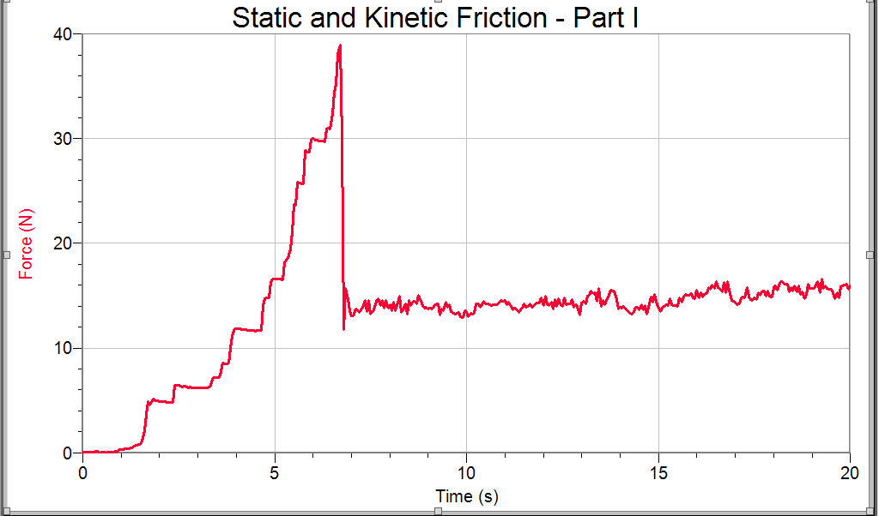
…or here?

Slide 11
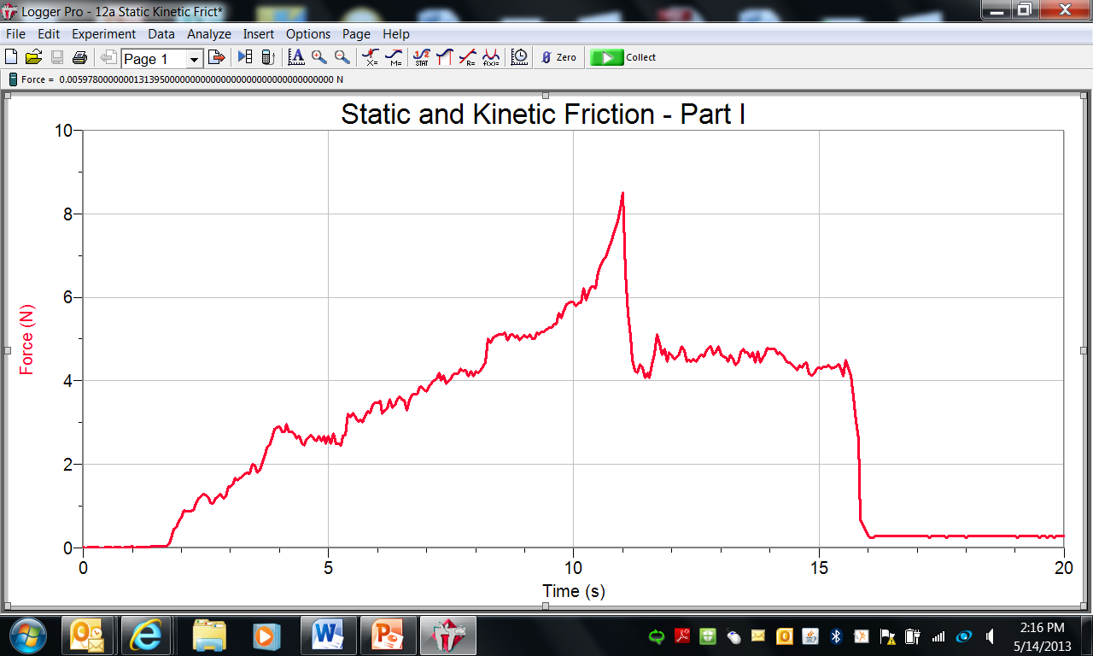

Slide 12
What factors affect (the size of) friction?
Survey says:
Surface texture
Surface material
Surface area
Speed of slide
Mass
Weight
Angle of surface
Normal Force

Slide 13
What really affects the friction force:
Is the object sliding or not
Surface type and texture
Normal force

Slide 14
What is the mathematical relationships between…
….the (horizontal) force (N) needed to just get an object sliding, and the normal force (N) acting on an object resting on a level surface?

Slide 15
What must you do to get an object to start sliding?

Slide 16
What must you do to get an object to start sliding?
Overcome the maximum static friction.
This means, there must be a force (or a component of a force) opposite the friction force that is larger in size than the biggest the static friction force can get.

Slide 17
Which FBD applies if the crate is stationary?

Slide 18
Which FBD applies if the crate is beginning to slide?

Slide 19
What must you do to keep an object sliding at a constant velocity?

Slide 20
Which FBD applies if the crate is sliding at a constant velocity?

Slide 21
What must you do to keep an object sliding?
To keep an object sliding at a constant velocity on a level surface, an applied (horizontal) force must be exactly the same size as the kinetic friction force.

Slide 22
Friction vs … (Optional)
1st: What is the mathematical relationship between the friction force (N) and the normal force(N) on an object that is sliding across a level aluminum surface at a constant speed.
Consider this: What is the normal force acting on a hovering hovercraft? How much friction does the floor exert on the hovercraft as it glides across the floor?
2nd: What is the … between the friction force (N) and the normal force(N) on an object that is sliding across a level rough surface at a constant speed.
3rd: What is the … between the friction force(N) and the surface area(cm²) between an object and the surface across which the object is sliding (at a constant speed).

Slide 23
Key concepts of Friction
Static friction – NOT sliding friction
Kinetic friction – sliding friction
The direction is always parallel to the surface interface, and in the opposite direction of the slide or the potential slide.
Friction can slow something down, or speed something up
Used to get around, keep knots tied, warm hands…

Slide 24
Friction vs Normal force
Kinetic friction acts when an object is SLIDING
F_{fk} = μ_{k}F_{n}
Kinetic friction is directly proportional to normal force. If you double the normal force, the kinetic friction force is doubled.
Static friction acts when an object is not sliding, but something is “trying” to make it slide.
F_{fs} < μ_{s}F_{n}
The maximum static friction is directly proportional to normal force. If you double the normal force, the maximum static friction force is doubled. However, the actual static friction force can be less than the maximum possible static friction force.
μ_{k}< μ_{s}

Slide 25
Other Factors
There exists no clear relationship between friction force and SURFACE AREA
As the surface is tilted more and more, the friction force lessens – BECAUSE THE NORMAL FORCE APPROACHES ZERO AS THE INCLINE ANGLE APPROACHES 90 DEGREES
Different surfaces all have different coefficients of friction (ex: Wood on sand paper> wood on rubber> wood on carpet)

Slide 26
Example Problem
A 100 kg crate rests on a level surface where the coefficients of static and kinetic friction are 0.6 and 0.4 respectively. How much force must be applied horizontally to:
A) get the crate to start sliding?
B) keep the crate sliding at a constant velocity?

Slide 27
Example (continued)
C) a horizontal force of 700 N is applied to the right. Compute the acceleration.
D ) it has been accelerated until it is going 5.0m/s to the right. Then the applied force is removed. How far will it slide before stopping?

Slide 28
Sliding into second base
During a ball game, a player running at 8.00 m/s attempts to slide onto second base. The coefficient of kinetic friction is 0.500. How far from the base can the slide start if the player comes to a stop AS he reaches the base?

Slide 29
While the man pulls with 30 N on the rope, the 5 kg sled with the 10 kg child moves at a constant velocity. The rope makes an angle of 30° above horizontal. What is the coefficient of kinetic friction?

